Slide 1
Danfoss-Mini TT Shaft Bearing Press
Team 512
February 29, 2024

Slide 2





Team Introductions
Clark Cooley
Systems Engineer
Cassie Bentley
Fluids Engineer
Colby Gullo
Safety Engineer
Brent Mynard
CAD Engineer

Slide 3



Sponsor and Advisor
Engineering Mentor
Kevin Lohman
Sponsor
Engineering Mentor
William Bilbow
Point of Contact & Sponsor
Academic Advisor
Shayne McConomy
Professor

Slide 4
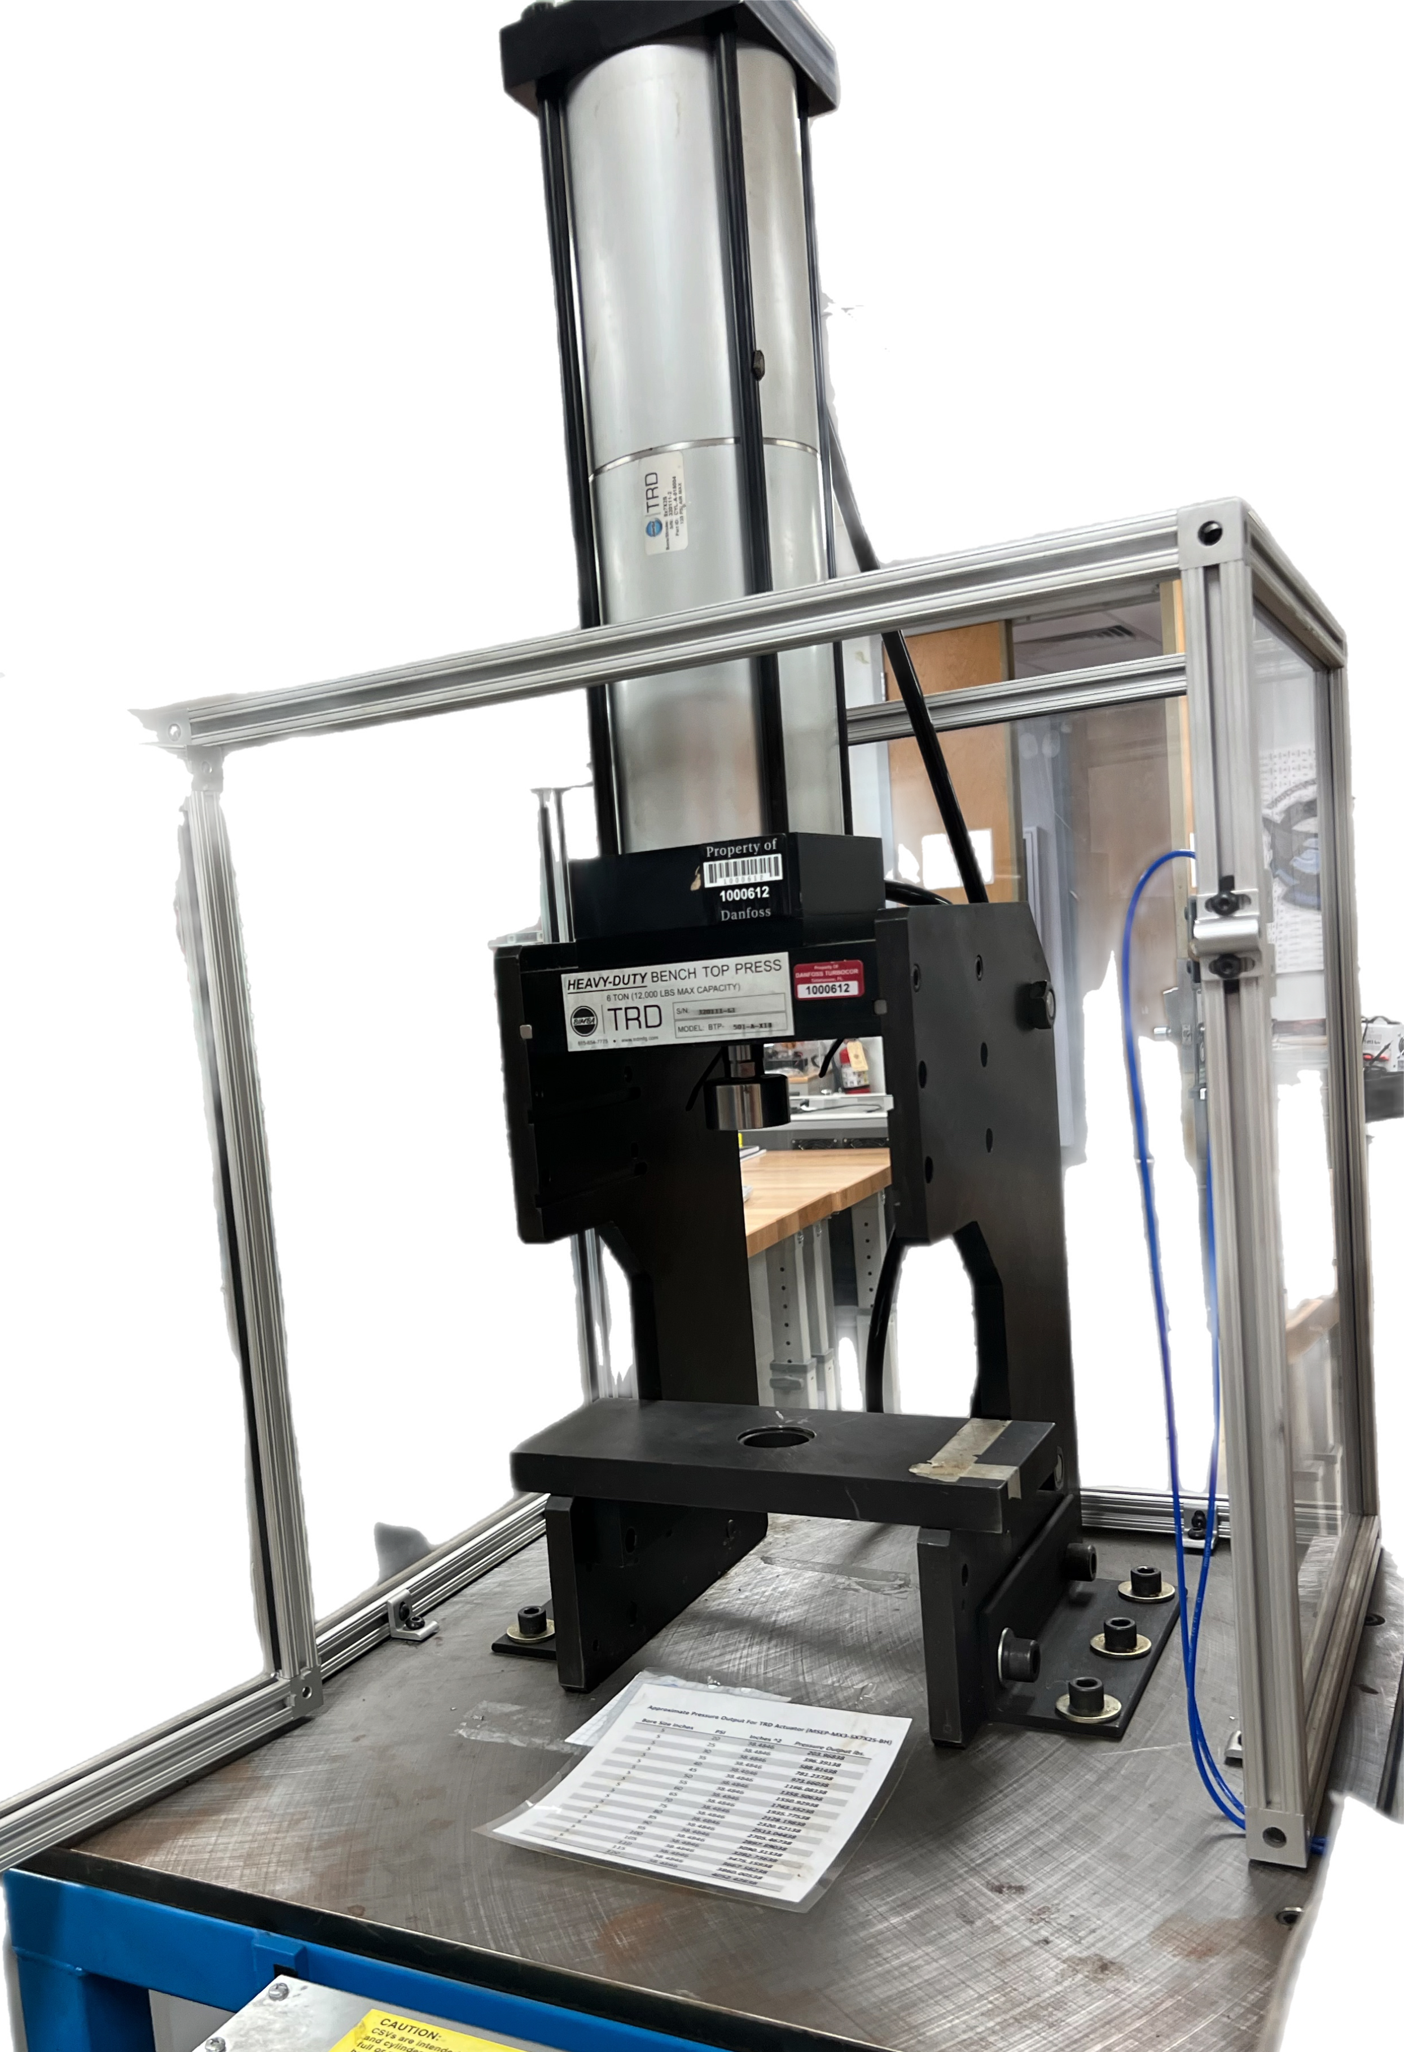
Objective
The objective of this project is to redesign the existing bearing press to press bearings of various sizes onto studs while ensuring ease of manipulation and user safety.

Slide 5
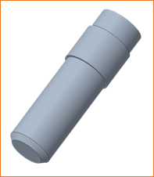
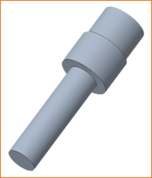
Our Project
Previous Shaft
Updated Shaft

Slide 6
Challenges & Decisions
Design
Safety
Additional Parts
New Press
Sponsor Does Not Like The Current Plexiglass
Will Be Shipped With Press
Last Semester
Budget Constraint
Time
No Longer Ordering A Press
Challenge
Remodeling Current Press
Metal Fabricator Constructs Cage
Ordering Each Part Individually
This Semester

Slide 7
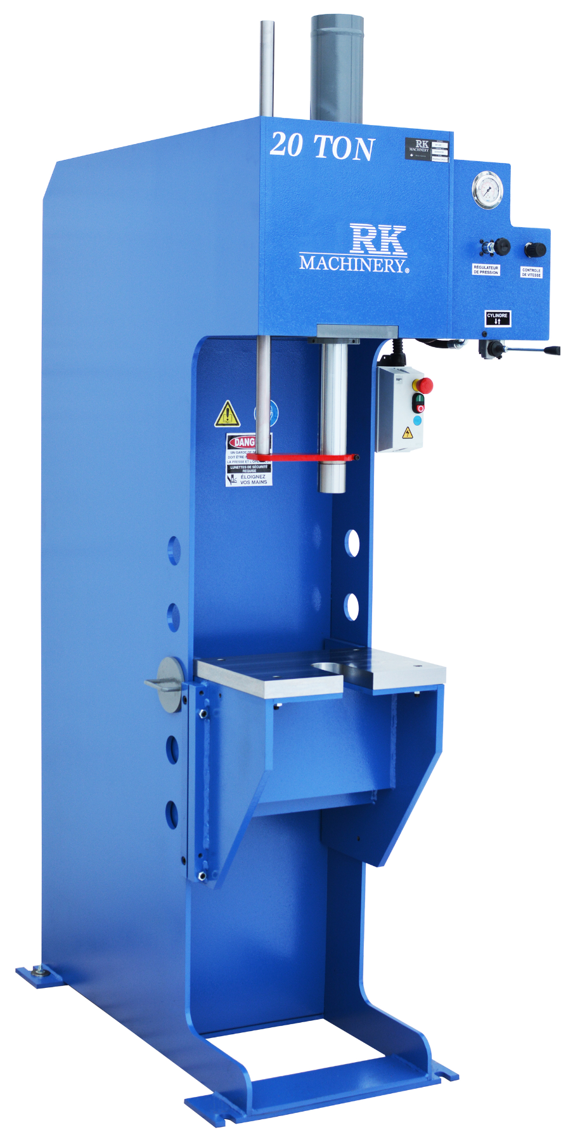

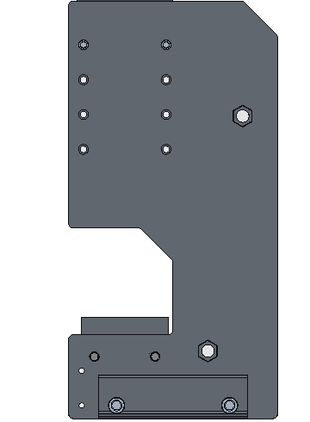
Challenges & Decisions
Design
New Press
Last Semester
Budget Constraint
Challenge
Remodeling Current Press
This Semester

Slide 8
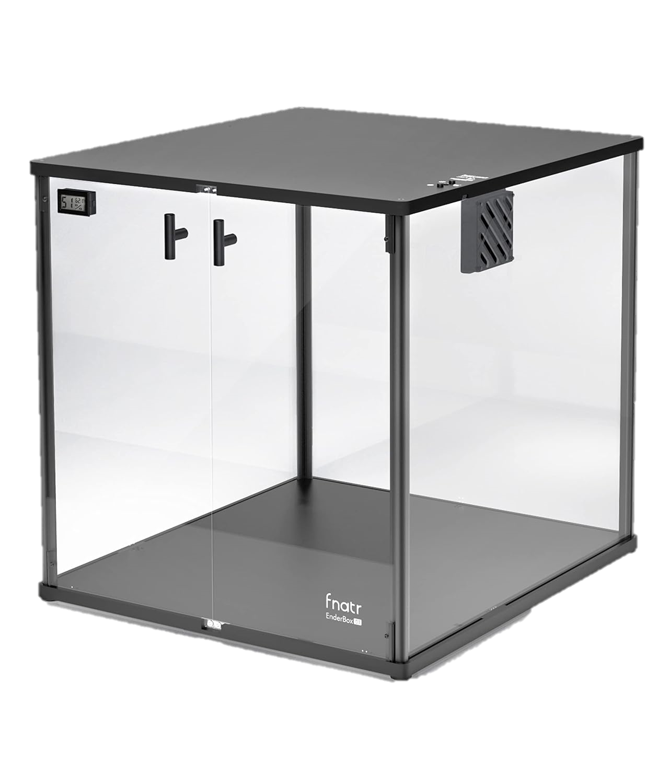

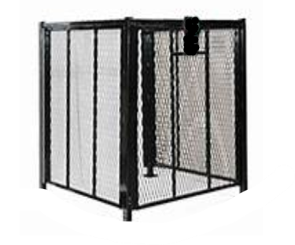
Challenges & Decisions
Safety
Sponsor Does Not Like The Current Plexiglass
Last Semester
Time
Challenge
Metal Fabricator Constructs Cage
This Semester

Slide 9



Challenges & Decisions
Additional Parts
Will Be Shipped With Press
Last Semester
No Longer Ordering A Press
Challenge
Ordering Each Part Individually
This Semester

Slide 10
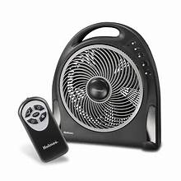
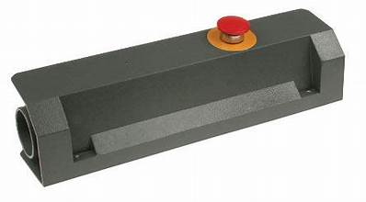
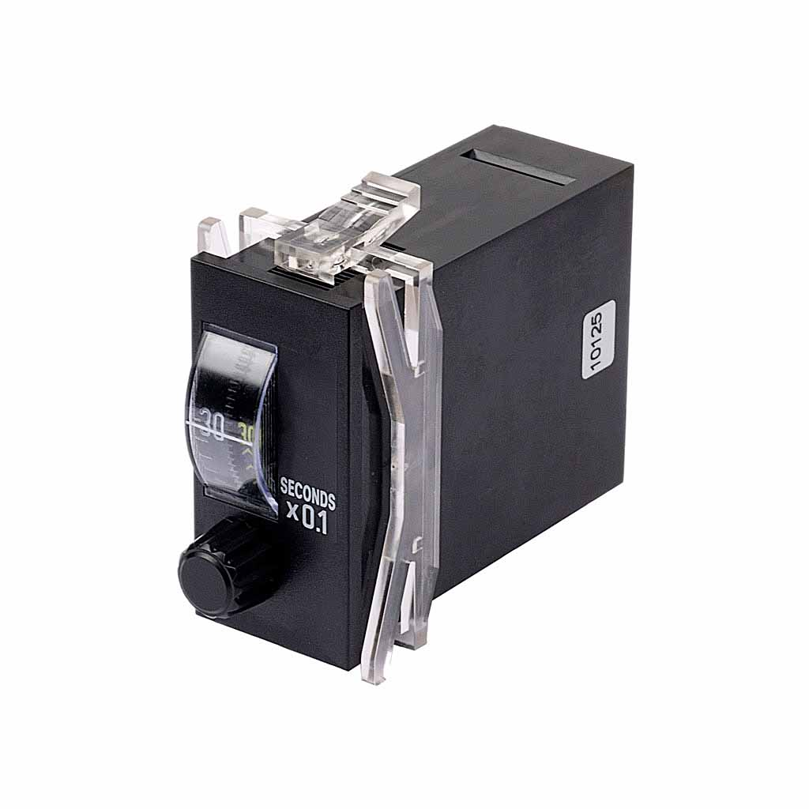
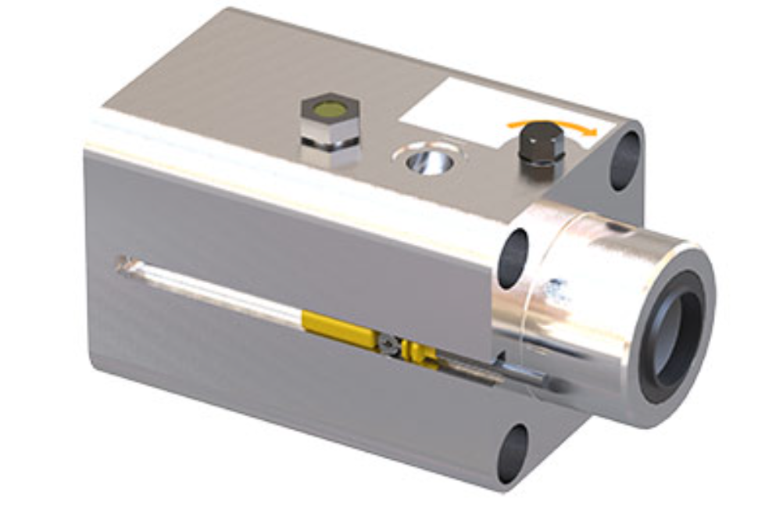
New Features
Keeping The Press Pneumatic

Slide 11
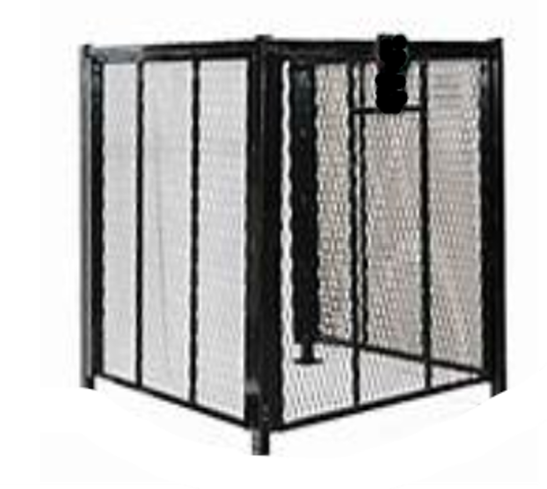
New Feature: Wire Mesh Cage
Made in Havana, GA
Must provide fabricator:
  Dimensions
  Door style
  Lock style

Slide 12
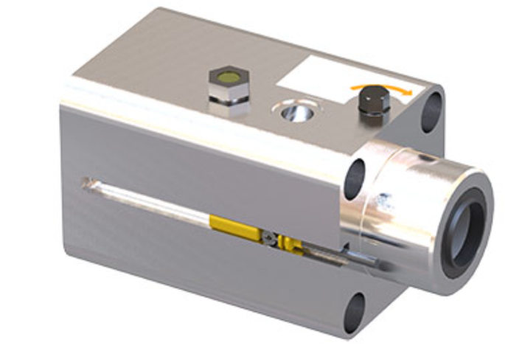
New Feature: Door Lock
Must be pneumatic
Should only activate when press is in use
Must recognize when door is open or closed

Slide 13

New Feature: Actuator with E-Stop
Actuator should require two hands
Emergency stop must immediately stop all actions

Slide 14
New Feature: Pneumatic Timer
Allows press to continue applying force for set time after actuator is released
Able to be overridden by emergency stop

Slide 15

New Feature: Fan
Allows for faster cooling of press and parts
May be electrical

Slide 16
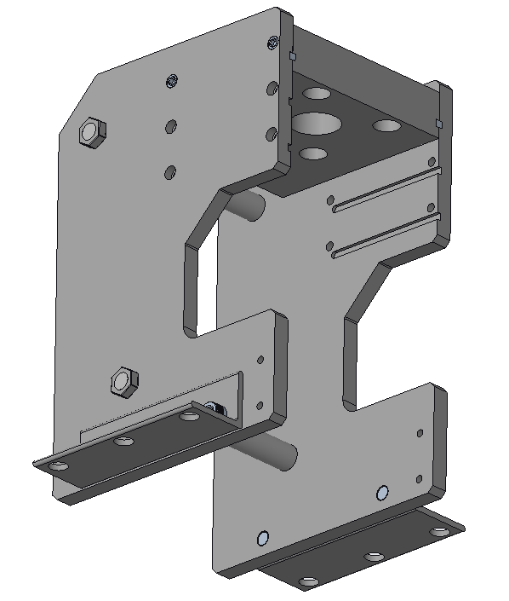
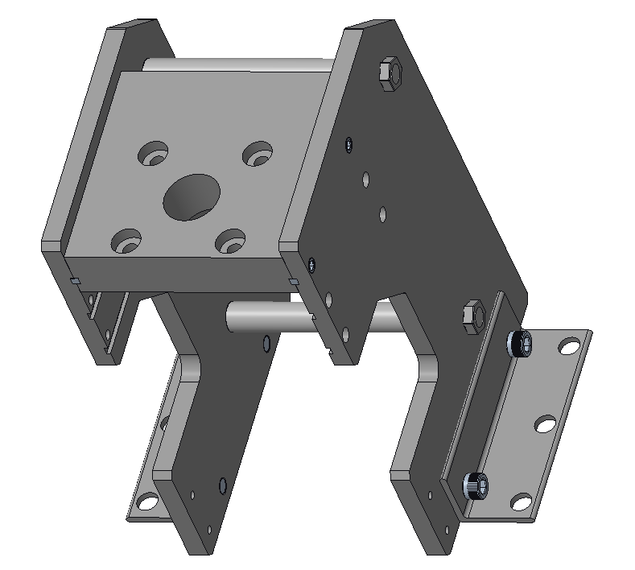
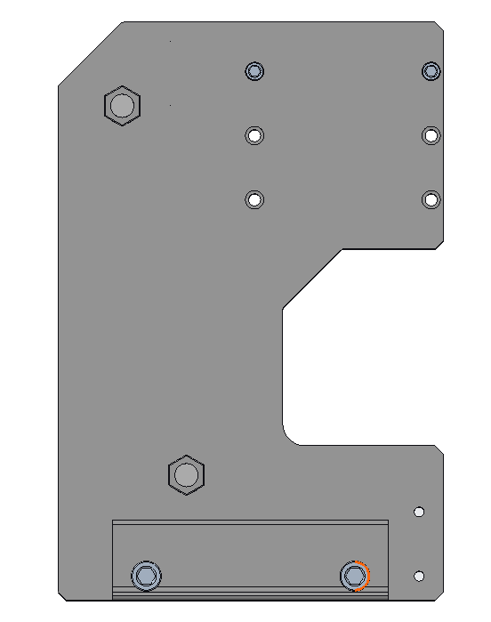
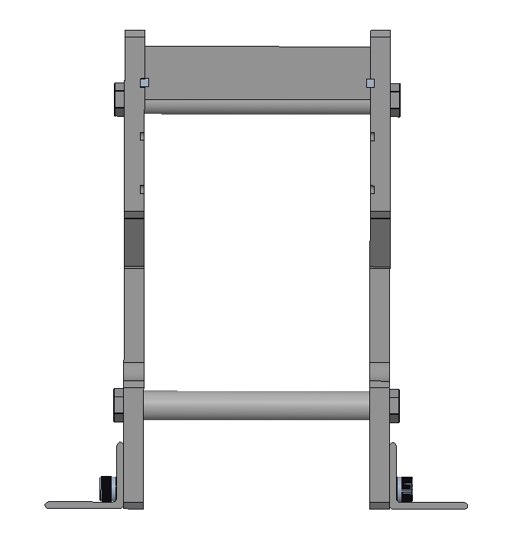
Original Press Design

Slide 17
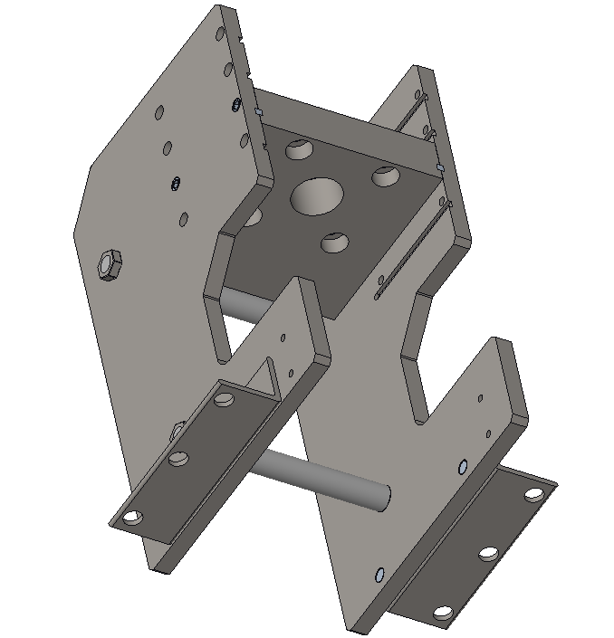
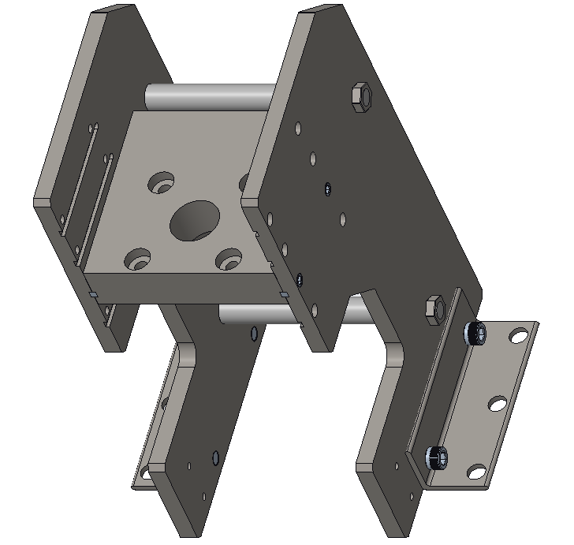
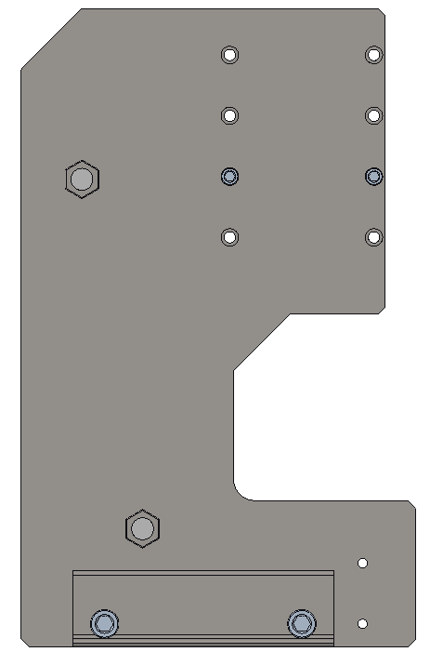
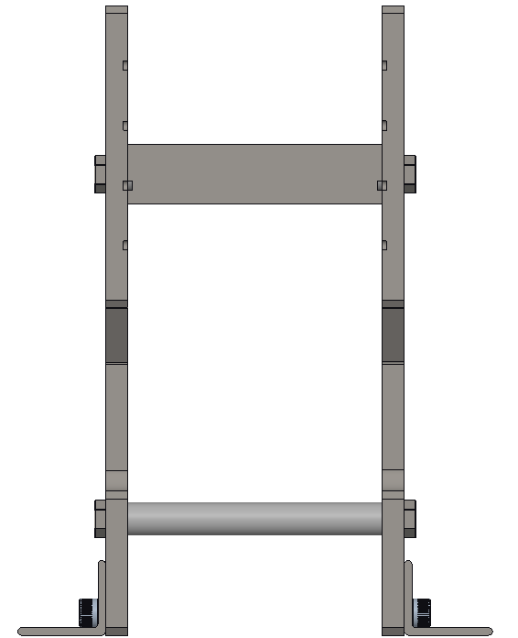
Original Improved Design

Slide 18
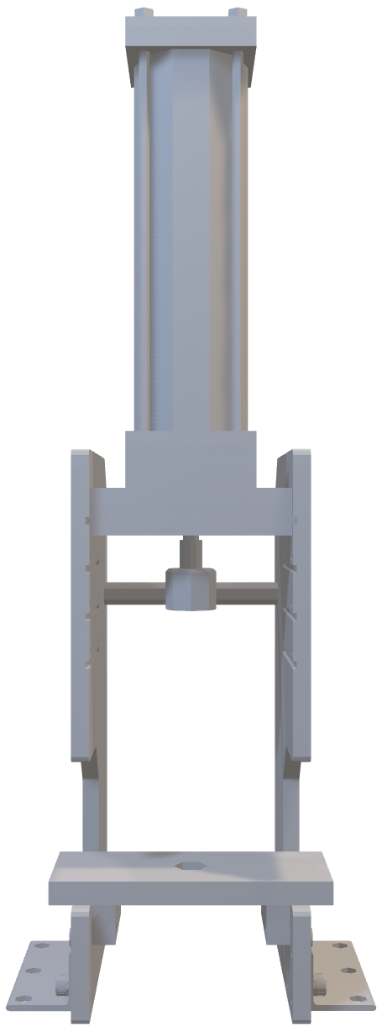
Revised Design
Improvements:
Increase height on side walls
Increase C-shape depth & height for better baseplate support
Additional slots for actuator plate
New Outer Dimensions:
Height: 24 in
Width: 9.98 in
Depth: 12 in

Slide 19
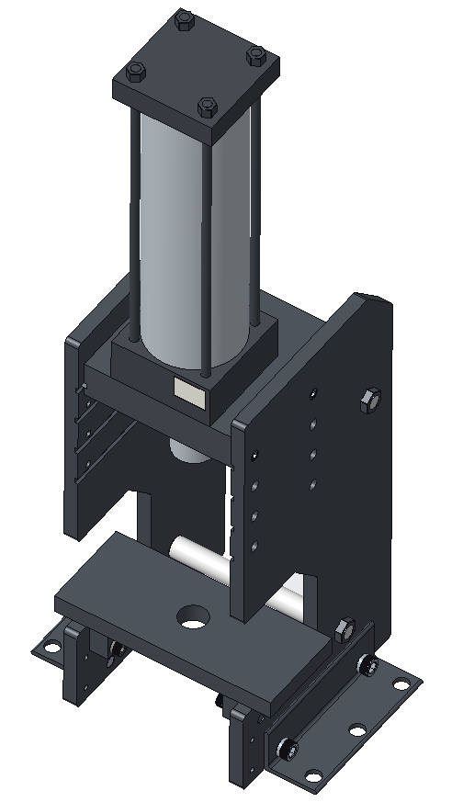
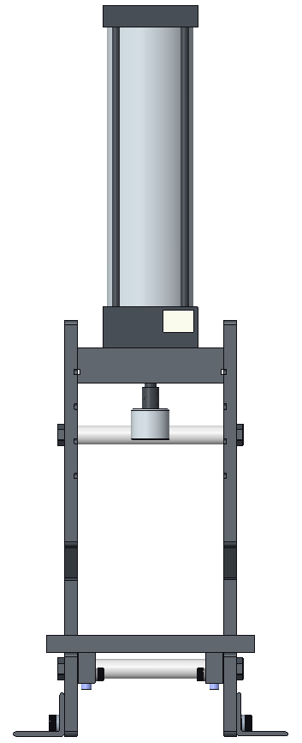
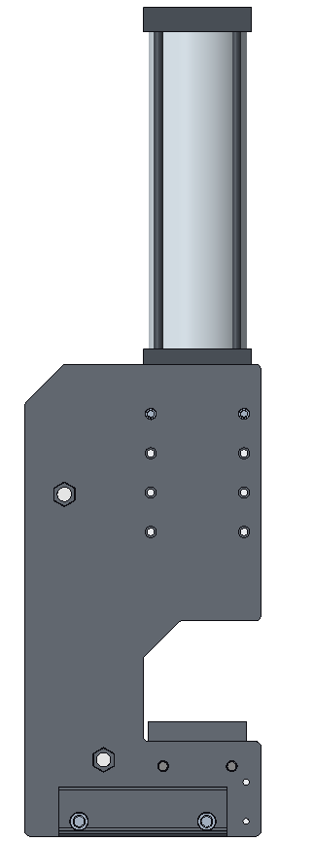
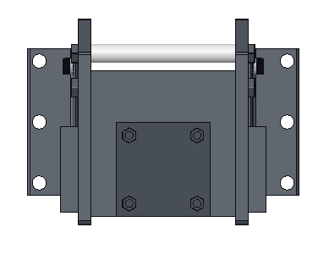
Revised Design

Slide 20
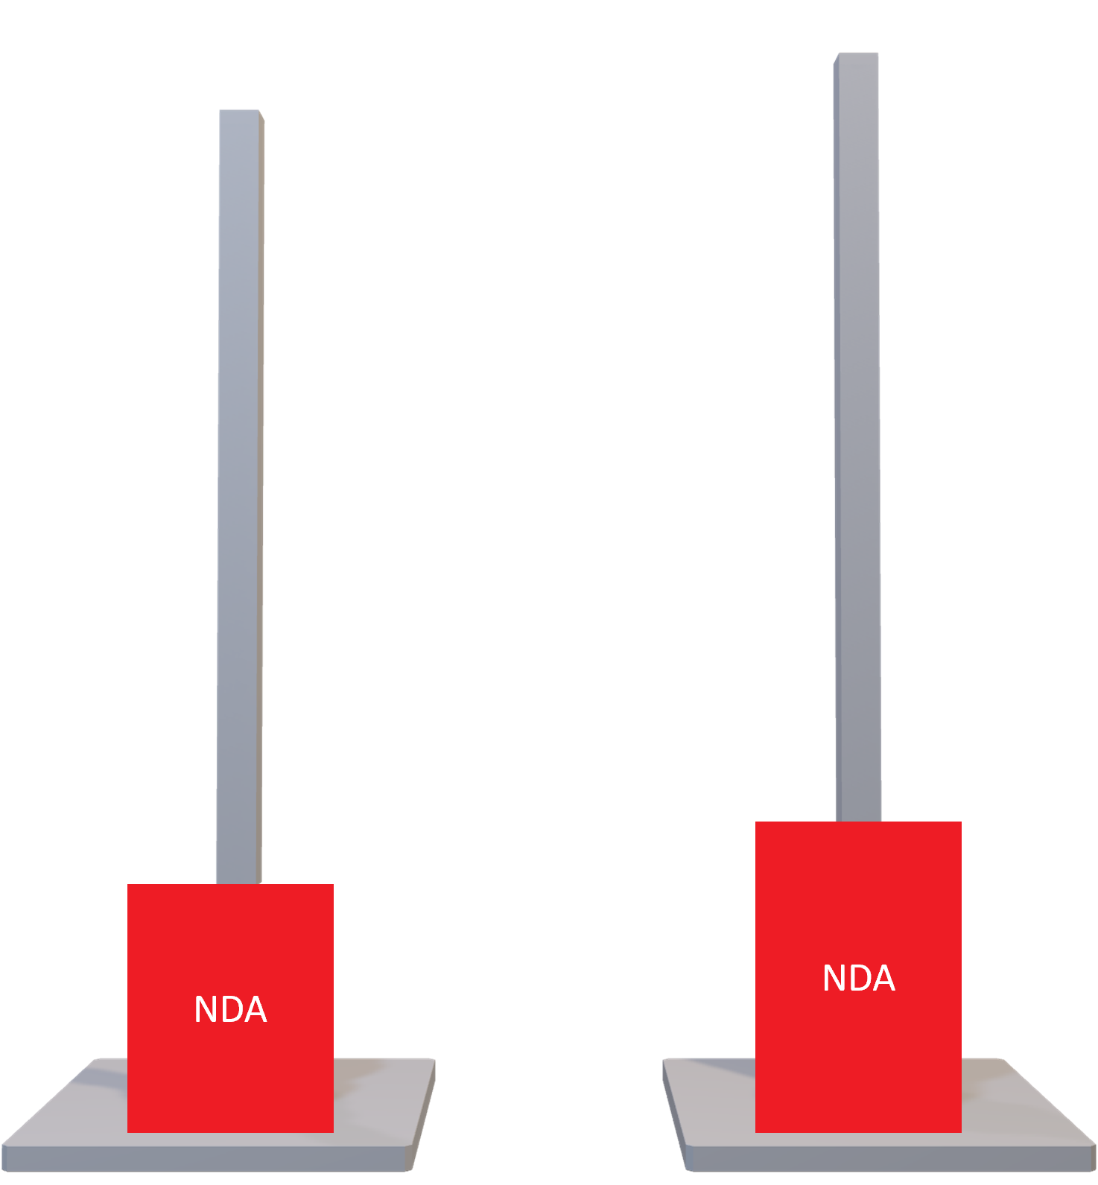
Bearing Housing
Dimensions:
Height: 4.9 ~ 5.6 in
Diameter: 3.9 in
Purpose:
Holds the bearing during pressing.
Accommodates the different shafts

Slide 21
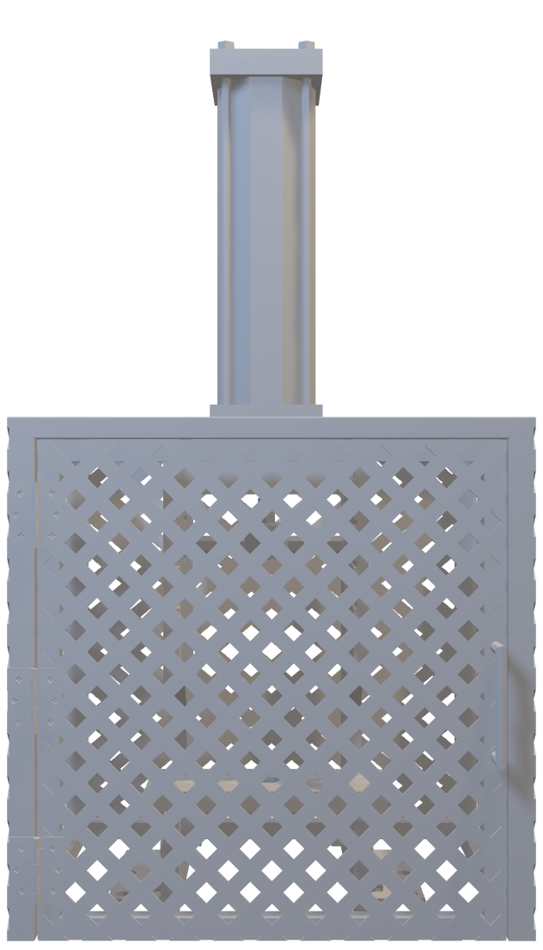
Cage Design
Improvements:
Stronger material
Pneumatic lock incorporation
Improved ventilation
New Outer Dimensions:
Height: 24 in
Width: 24 in
Depth: 18 in
Bar Thickness: 1 in

Slide 22
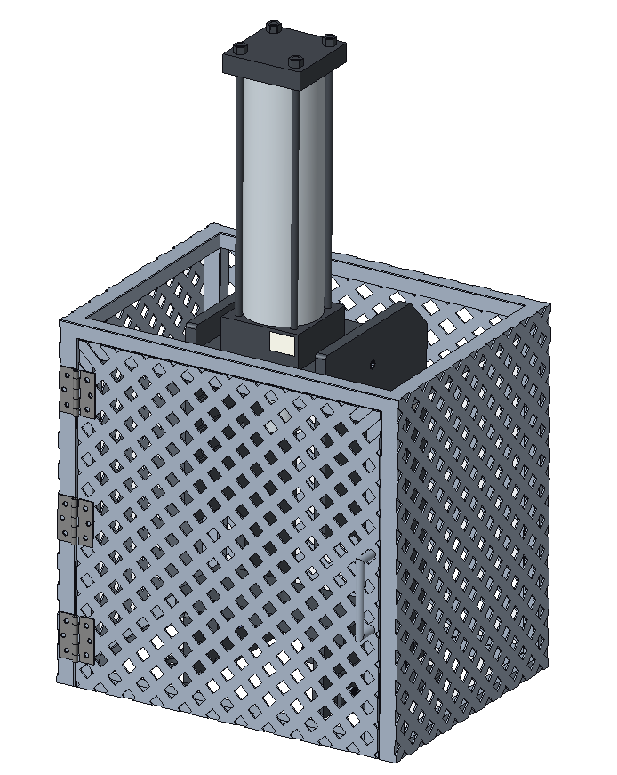
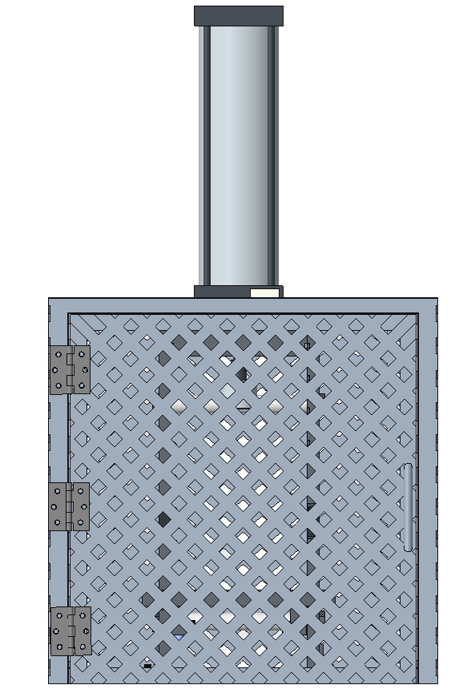
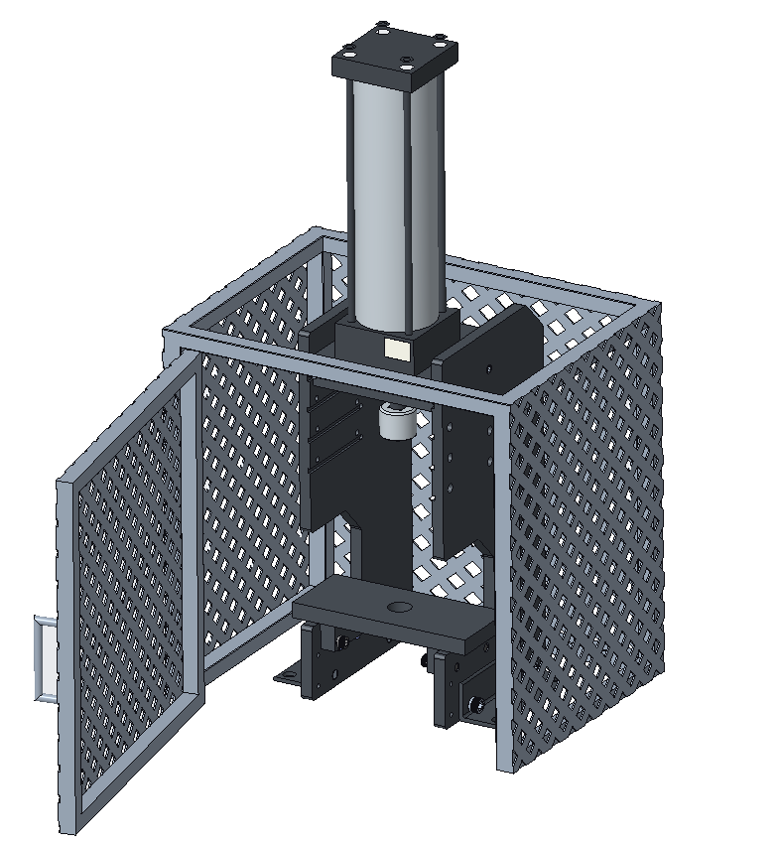
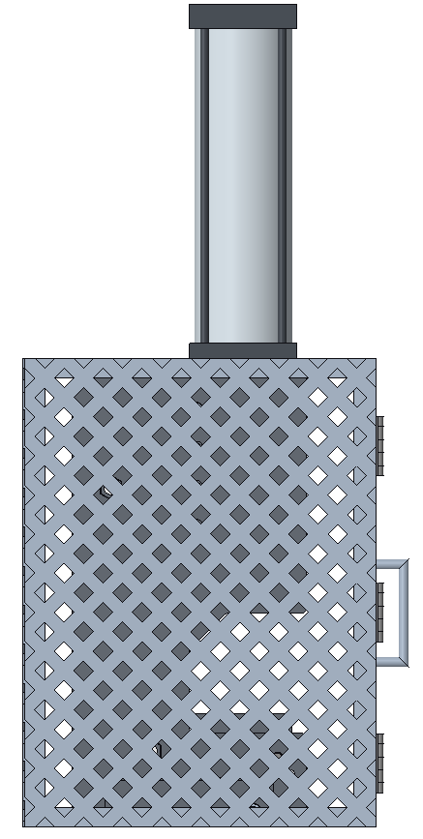
Cage Design

Slide 23
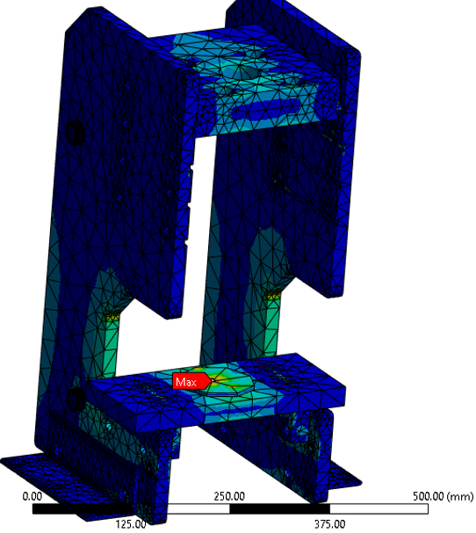
Stress Test: 1018 Steel
MAX
21.001 MPa
18.668 MPa
16.334 MPa
14.001 MPa
11.667 MPa
9.334 MPa
7.0005 MPa
4.667 MPa
2.3335 MPa
MIN
8.4166e-7 MPa

Slide 24
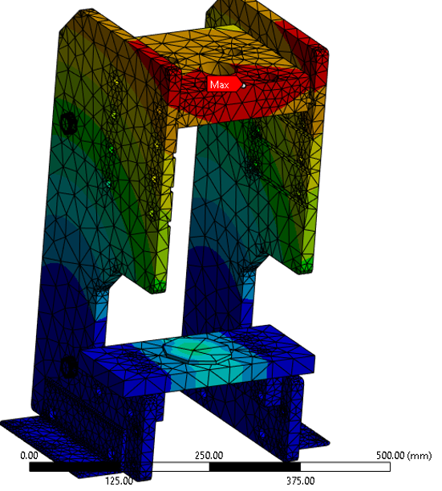
Deformation Test: 1018 Steel
MAX
0.05259 mm
0.046746 mm
0.040903 mm
0.03506 mm
0.029217 mm
0.023373 mm
0.01753 mm
0.011687 mm
0.0058433 mm
MIN
0.0 mm

Slide 25
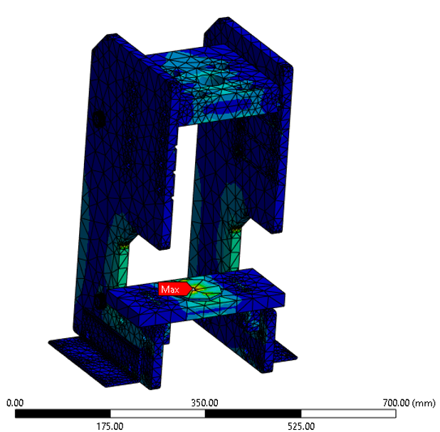
Stress Test: 4140 Steel
MAX
21.001 MPa
18.668 MPa
16.334 MPa
14.001 MPa
11.667 MPa
9.334 MPa
7.0005 MPa
4.667 MPa
2.3335 MPa
MIN
8.4165e-7 MPa

Slide 26
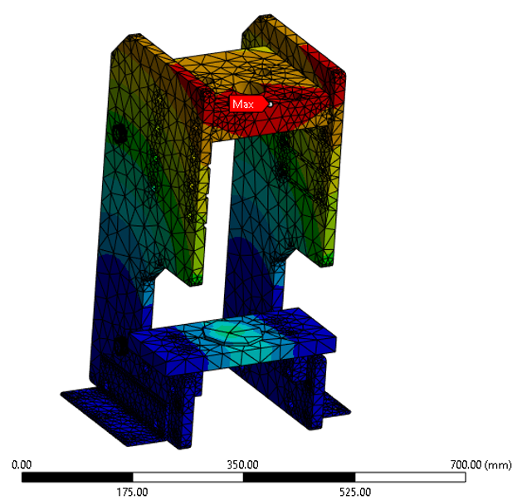
Deformation Test: 4140 Steel
MAX
0.051483 mm
0.045762 mm
0.040042 mm
0.034322 mm
0.028601 mm
0.022881 mm
0.017161 mm
0.011441 mm
0.0057203 mm
MIN
0.0 mm

Slide 27


Thank you

Slide 28
Slides we are not using …....

Slide 29
Current Semester: Milestone Updates
Old Press Design

Slide 30
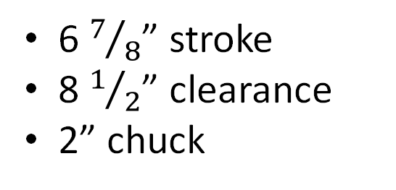
Old Design
6 $7/8$” stroke
8 $1/2$” clearance
2” chuck

Slide 31
Current Semester: Milestone Updates
New Press Design

Slide 32
Current Semester: Milestone Updates
New Press Design

Slide 33
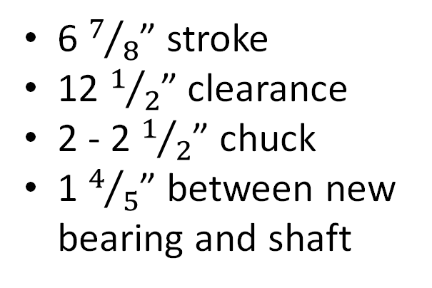
New Design
6 $7/8$” stroke
12 $1/2$” clearance
2 - 2 $1/2$” chuck
1 $4/5$” between new bearing and shaft

Slide 34
Backup Slides

Slide 35
This is 10-point
This is 15–point Times
This is 20–point
This is 25–point
This is 30–point
This is 35–point
This is 40–point
This is 50–point
This is 60–point
This is 72–point
Notes:
Use at least 20-point font in Room A105, B134, and B136
Use at least 25-point font in Room B135

Slide 36
College of Engineering Color Palette
1 2 3 4
Pantone: PMS 195 C
RGB: 120, 47, 64
Hex: #782F40
CMYK:19, 90, 50, 55
1 2 3 4
Pantone: Black C
RGB: 0, 0, 0
Hex: #000000
CMYK:0, 0, 0, 100
Garnet
Black
1 2 3 4
RGB: 238, 118, 36
Hex: #EE7624
CMYK:2, 66, 99, 0
1 2 3 4
Pantone: PMS 000C
RGB: 255, 255, 255
Hex: #FFFFFF
CMYK: 0, 0, 0, 0
Fang
Orange
White
Notes:
Avoid 75% Black in B135

Slide 37
Accent Color Palette
1 2 3 4
RGB: 0, 59, 111
Hex: #003B6F
CMYK:
1 2 3 4
RGB: 0, 59, 111
Hex: #003B6F
CMYK:
1 2 3 4
RGB: 251, 236, 93
Hex: #FBEC5D
CMYK:
1 2 3 4
RGB: 219, 215, 210
Hex: #DBD7D2
CMYK:
1 2 3 4
RGB: 251, 236, 93
Hex: #FBEC5D
CMYK:
1 2 3 4
RGB: 219, 215, 210
Hex: #DBD7D2
CMYK:
Tardis Blue
Tardis Blue
Corn
Timberwolf
Corn
Timberwolf
1 2 3 4
RGB: 206, 0, 88
Hex: #CE0058
CMYK: 0, 100, 43, 12
1 2 3 4
RGB: 206, 0, 88
Hex: #CE0058
CMYK: 0, 100, 43, 12
1 2 3 4
RGB: 104, 40, 96
Hex: #682860
CMYK:
1 2 3 4
RGB: 220, 220, 220
Hex: #DCDCDC
CMYK:
Rubine Red
Rubine Red
Imperial
Gainsboro
1 2 3 4
RGB: 72, 146, 155
Hex: #48929b
CMYK:
1 2 3 4
RGB: 64, 224, 208
Hex: #40E0D0
CMYK:
1 2 3 4
RGB: 255, 139, 0
Hex: #FF8B00
CMYK:
Asagi-iro
Turquoise
American Orange
Notes:
Remove American orange add hyperlink grey
Make corn the last for b135
All work in 134 imperial move later
Tardis doesn’t work in b136

Slide 38
F7AB19
D67F15
EE7624
D64615
F73119
Analogous
https://color.adobe.com/create/color-wheel
6E3610
F0A16C
EE7624
6E4931
BASB1C
Monochromatic
A14508
4BED3B
EE7624
250CED
2010A1
Triad
A1470C
FF8C40
EE7624
0098A1
24E2ED
Complementary
28A164
2FED8D
EE7624
0848A1
1871ED
Split Complementary
EDAC2F
3BED93
EE7624
0C6AED
ED2F18
Double Split Complementary
ED660C
C7ED3B
EE7624
0CE1ED
A418ED
Square
BA7E09
87724A
EE7624
60EFCF
09BA61
Compound
AD551A
6E3610
EE7624
FA7625
D46820
Shades
Notes:
These are the variants that work well with Fang Orange. The bolded items show well on the projectors.

Slide 39
85412D
8F3831
782f40
8F3176
792D85
Analogous
https://color.adobe.com/create/color-wheel
C44D69
8E626D
782F40
C48796
451B25
Monochromatic
C43959
78743B
782F40
236178
43A2C4
Triad
C43959
C46078
782F40
25C43D
2F783A
Complementary
93C460
577835
782F40
39C49D
297861
Split Complementary
784435
5A783B
782F40
237860
6E2978
Double Split Complementary
782337
78683b
782F40
237830
293978
Square
AB4D32
DEBAAF
782F40
5D8555
70AB32
Compound
38161E
C44D69
782F40
853447
5E2532
Shades

Slide 40
A105
A105
B135 Stage Left
B135 Stage Right
B136
B134, A105
B135

